Slide 1
HR ANALYTICS
​WELCOME
TO
PRESENTATION

Slide 2

Meet our team
Supriya Siddhappa Harake
Omkar Suresh Dhanave
Priyanka Mallu Powar
Sayali Ramesh Mane
Uday Sanjay Mantri
Priyanka D

Slide 3
Introduction
HR analytics project endeavors to harness the power of data to drive strategic HR decision-making and enhance organizational performance. By leveraging KPIs and analytical tools such as Excel, MySQL, Tableau, and Power BI, we aim to unlock valuable insights into workforce dynamics, thereby enabling organizations to optimize their HR strategies, foster employee engagement, and achieve sustainable growth in today's competitive business environment.

Slide 4





Tools Used In Project
Excel
Tableau
Power Bi
MySQL

Slide 5



KPIs
HR
ANALYTICS
Average Attrition Rate For All Departments
Average Hourly Rate Of Male Research Scientist
Attrition Rate VS Monthly Income Stats
Average Working Years For Each Department
Job Role VS WorkLife Balance
Attrition Rate VS Year Since Last Promotion Relation

Slide 6
KPI-1 Average Attrition Rate For All Departments
Summary:
The HR analytics project focuses on assessing attrition rates across all departments, revealing a consistent range of 49.44% to 51.21%. The summarized bar graph illustrates this range effectively, highlighting attrition as a critical KPI. By narrowing the focus to "attrition yes rate," the analysis emphasizes the proportion of employees leaving the organization, providing actionable insights for strategic HR decision-making..
Suggestion:
To address attrition, implement strategies such as improving communication, offering competitive compensation and benefits, and providing opportunities for career growth and development tailored to the needs of each department.
Conclusion:
The analysis underscores the importance of understanding and mitigating attrition across departments to maintain organizational stability and foster a positive work environment conducive to employee retention and satisfaction.

Slide 7
KPI -2 Average Hourly Rate Of Male Research Scientist
Summary:
The analysis reveals the average hourly rate of male research scientists, providing a key insight into gender-based pay disparities within this role where the average hourly rate of male research scientist is 114.45
Suggestion:
To address potential gender pay gaps, it's recommended to conduct a comprehensive review of compensation structures and ensure equitable remuneration based on skill, experience, and performance.
Conclusion:
The findings highlight the importance of promoting pay equity and transparency to foster a fair and inclusive workplace environment, ultimately enhancing employee morale and organizational reputation.

Slide 8
KPI-3 Attrition Rate VS Monthly Income Stats
Summary:
The comparison between attrition rates and monthly income statistics reveals potential correlations between employee turnover and compensation levels, providing valuable insights into workforce dynamics which ranges from 49.44% to 51.21%.
Suggestion:
To mitigate attrition, it's advisable to review compensation structures and consider implementing adjustments or incentives to align with industry standards and employee expectations.
Conclusion:
The analysis underscores the significance of addressing compensation-related factors in retention strategies, emphasizing the need for fair and competitive pay to promote employee satisfaction and reduce turnover rates, thereby fostering organizational stability and growth.

Slide 9
KPI-4 Average Working Years For Each Department
Summary:
The calculation of average working years for each department sheds light on the tenure distribution within the organization, highlighting potential differences in employee retention and career progression across departments which ranges from 20.32 to 20.67.
Suggestion:
To enhance employee retention and career development, consider offering targeted training and advancement opportunities based on departmental needs and individual aspirations.
Conclusion:
The analysis underscores the importance of investing in professional growth and succession planning tailored to each department's unique dynamics, fostering a loyal and skilled workforce while ensuring organizational resilience and continuity.

Slide 10
KPI-5 Job Role VS Work Life Balance
Summary:
The evaluation of job roles against work-life balance metrics provides insights into how different positions impact employees' ability to maintain a healthy work-life equilibrium, crucial for overall well-being and job satisfaction which ranges between 2.47 to 2.51.
Suggestion:
To optimize work-life balance, consider implementing flexible work arrangements, promoting time management strategies, and fostering a culture that prioritizes employee well-being.
Conclusion:
The analysis underscores the importance of aligning job roles with work-life balance considerations, emphasizing the need to tailor policies and practices to support employees in achieving harmony between their professional and personal lives, ultimately enhancing productivity, morale, and retention.

Slide 11
KPI-6 Attrition Rate VS Year Since Last Promotion Relation
Summary:
Examining the relationship between attrition rate which ranges from 49.44% to 51.21% and time since last promotion offers insights into the impact of career advancement opportunities on employee retention, highlighting potential correlations between job satisfaction and progression which ranges from 5.8 to 6.0
Suggestion:
To mitigate attrition and promote employee engagement, prioritize career development initiatives, offer transparent promotion pathways, and provide regular feedback and recognition to employees.
Conclusion:
The analysis underscores the importance of aligning promotion practices with retention efforts, emphasizing the need to foster a supportive environment that recognizes and rewards employee contributions, thereby enhancing job satisfaction and reducing turnover rates for long-term organizational success.

Slide 12






HR Analytics Dashboard
Excel Dashboard
Total Employees
50000
Attrition Rate
50.21%
Male
25059
Female
24941
Department
Hardware
Human resources
Sales
Support
Research & Devel…
Software

Slide 13
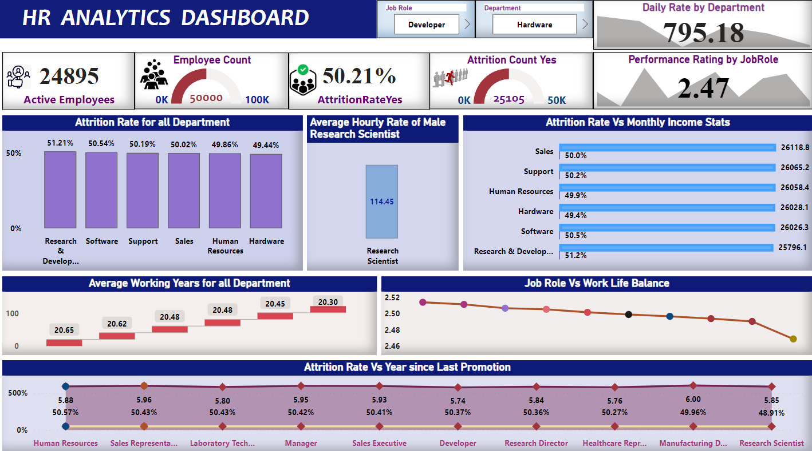
Power Bi Dashboard

Slide 14
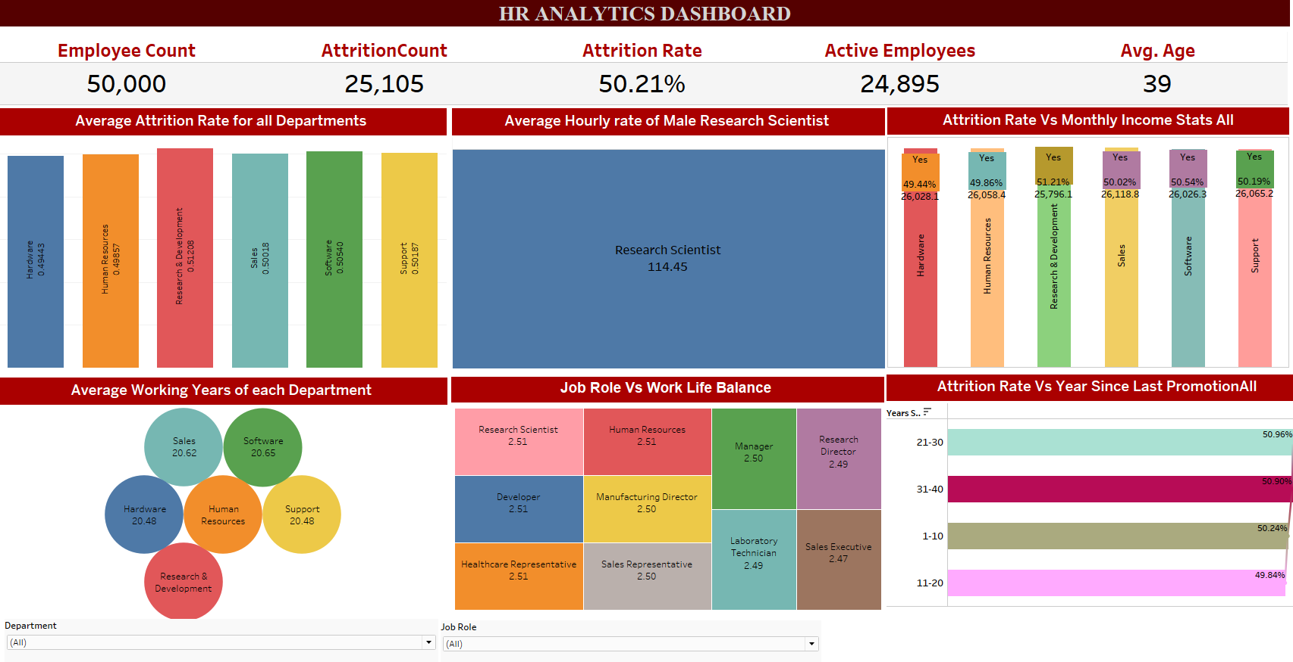
Tableau Dashboard

Slide 15
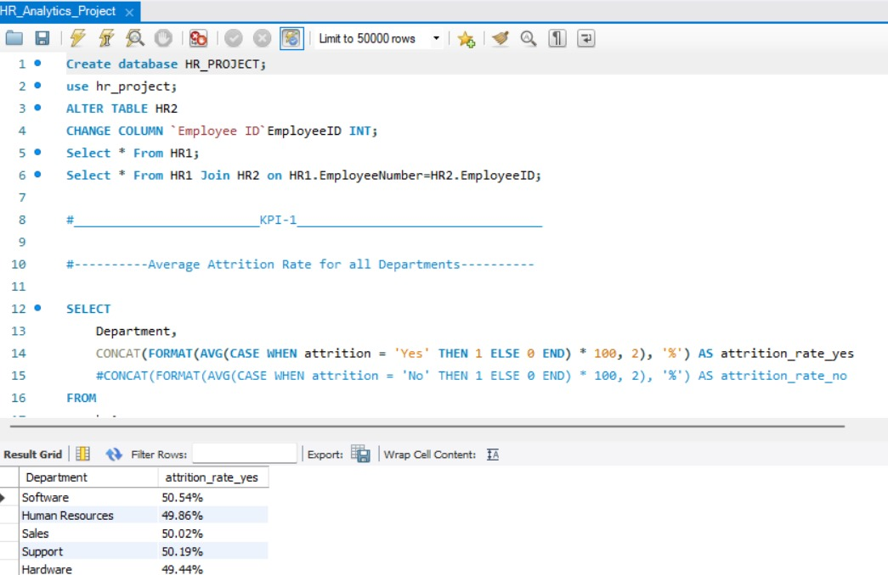
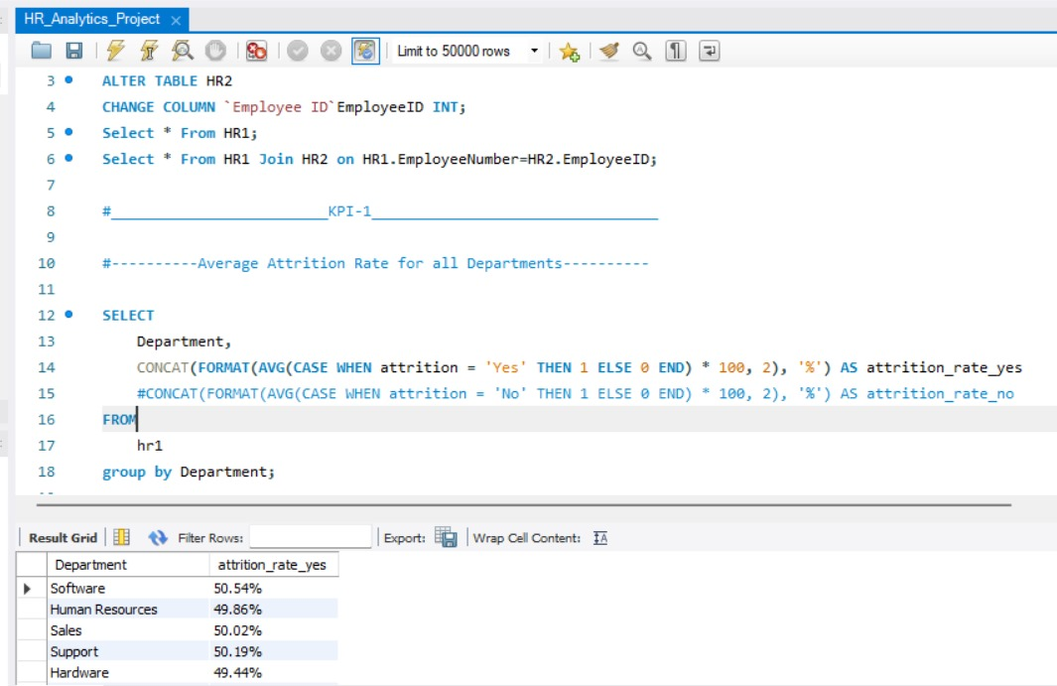
SQL Queries

Slide 16
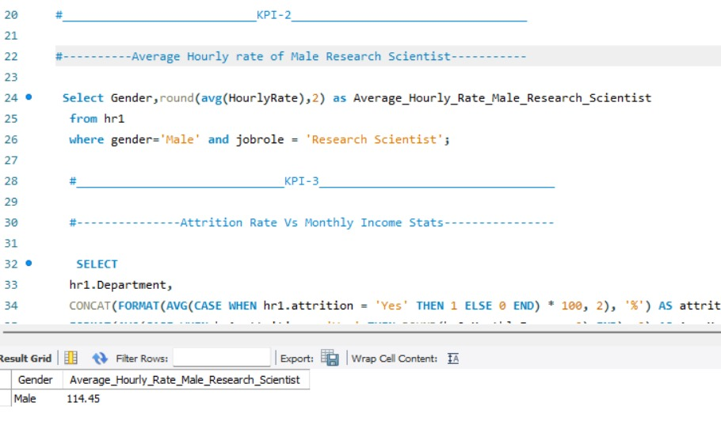

Slide 17
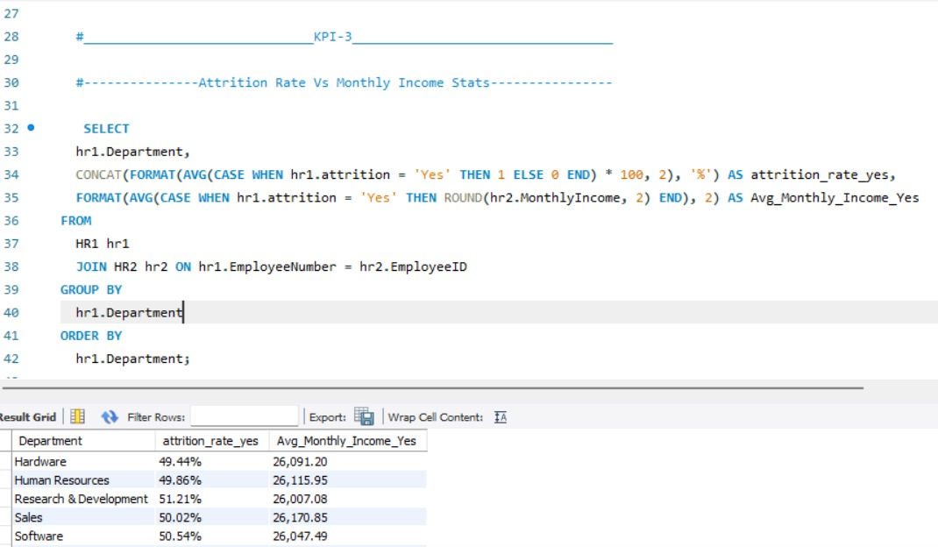

Slide 18
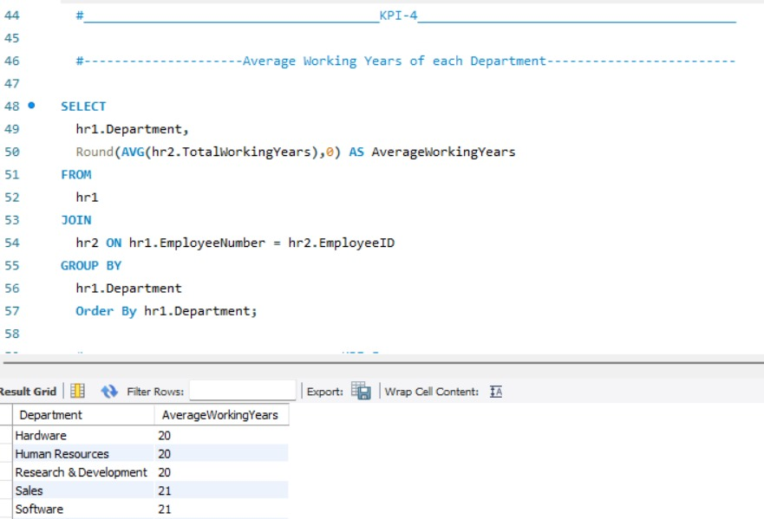

Slide 19
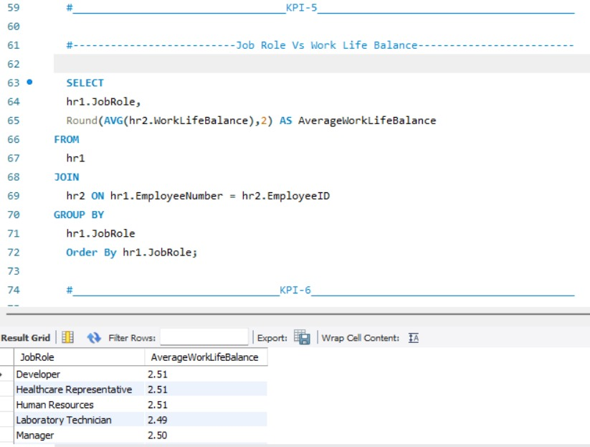

Slide 20
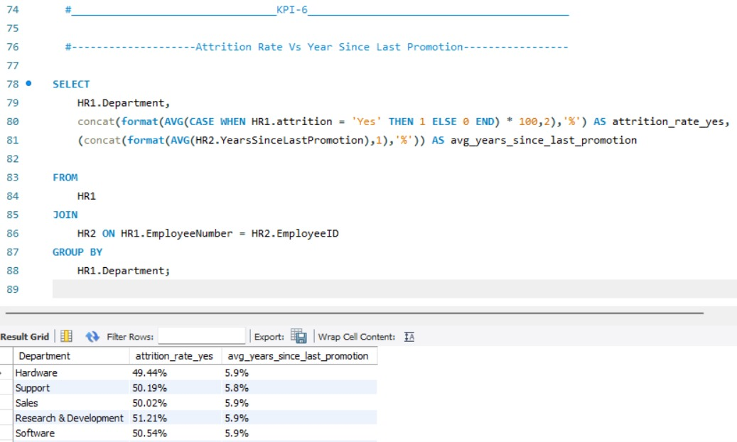

Slide 21
….THANK YOU….

